Slide 1

Paid Time Off (PTO)
PAID TIME OFF (PTO) WITH ACCRUAL PROVISIONS AND TIME RECORDING POLICY

Slide 2
Agenda
Review the Paid Time Off Policy that will be effective 07/01/2023
Live Demo
Questions are welcomed. Please use the chat feature of ZOOM for questions

Slide 3

Policy Purpose and Statement
Oberlin College believes that its employees are the key to what makes a great institution.
We believe that a balance between work and personal activities is essential to maintain quality performance and a positive work atmosphere.
The College has designed a paid time off (PTO) plan that incorporates vacation, personal and sick leave into one program.
It is intended that this policy will offer guidance to A&PS and Confidential employees regarding the college's paid time off program

Slide 4

Eligibility
This policy applies to individuals who meet any of the following criteria:
Full time or part time Administrative & Professional Staff
Full time or part time Confidential employees
YOUR IMAGE HERE

Slide 5

Provisions - Full Time, 12-month appointments
A&PS and Confidential employees on full-time, 12-month appointments will accrue two hundred eight (280) hours (35 eight-hour days) of PTO per fiscal year, which will begin to be earned July 1 through June 30 of each academic year.
PTO may be taken, as earned, during the fiscal year at times approved by an employee's supervisor.
YOUR IMAGE HERE
Notes:
23.33 hours per month loaded which will be available on the first of the following month

Slide 6
Provisions - Less than full-time
A&PS and Confidential employees who begin employment after July 1 of a fiscal year, or who are on less than full-time, 12-month appointments, will accrue PTO time on a pro-rated basis.
Pro-rated accruals for those hired after July 1 will begin on the first of the following month and may be taken, as earned, during the fiscal year at times approved by the employee's supervisor.
Employees with less than a 1.0 FTE will earn PTO on a prorated accrual basis.
Employees will be restricted from using any earned PTO within the first forty-five (45) days of employment, unless agreed to prior to being hired.

Slide 7
Procedures - General
PTO is designed to cover leave for vacation, personal sickness, family sickness and other personal, scheduled, and unscheduled activities.
Employees are not permitted to utilize PTO hours they have not accrued. Exceptions must be approved by the Department of Human Resources and supervisor.
In general, all PTO must be pre-approved by and pre-scheduled with an employee's supervisor and can be taken in 1-hour increments. Approval for all scheduled time away is subject to applicable workloads and staffing needs.

Slide 8
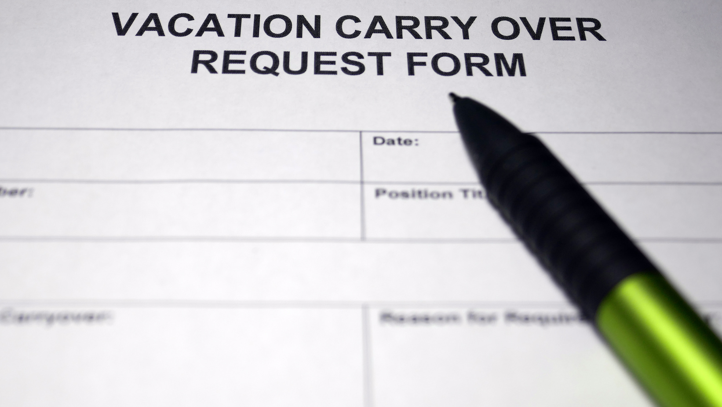
Procedures - Carry Over
Annually on July 1, full-time employees will be able to carry forward a maximum of one hundred twenty (120) hours (15 eight-hour days) into the next fiscal year. Employees will forfeit any unused PTO from a prior fiscal year, other than days carried forward.
Full time employees may bank a maximum of four hundred fifty six (456) hours (57 eight hour days) of PTO within the 2023-2024 fiscal year, due to the conversion of PTO.
Beginning on July 1, 2024, full time employees may annually bank a maximum of four hundred (400) hours (50 eight-hour days) of PTO.
Ex. 120 hours of carry over and 280 hours of PTO to earn per fiscal year.

Slide 9

Procedures - Separation from the College
If an employee leaves the college, they will be paid for unused PTO earned only in the current fiscal year of their departure, at a maximum of one hundred sixty (160) hours (20 eight-hour days), less any applicable payroll deductions.
Employees will not be paid for PTO carried over from a prior fiscal year.

Slide 10
Family and Medical Leave (FMLA) / Short-Term Disability Leave
For approved FMLA leaves, the employees must utilize, and exhaust all earned available PTO and PTO carryover time before transitioning to an unpaid FMLA status.
Employees who qualify for paid Short-Term Disability leave must utilize and exhaust accrued, available PTO and PTO carryover time more than forty (40) hours (5 eight-hour days) before receiving paid Short-Term Disability Leave.
PTO time and Short-Term Disability Leave used for FMLA purposes will run concurrently with FMLA leave.
Employees who are on Short-Term Disability Leave do not accrue PTO.

Slide 11
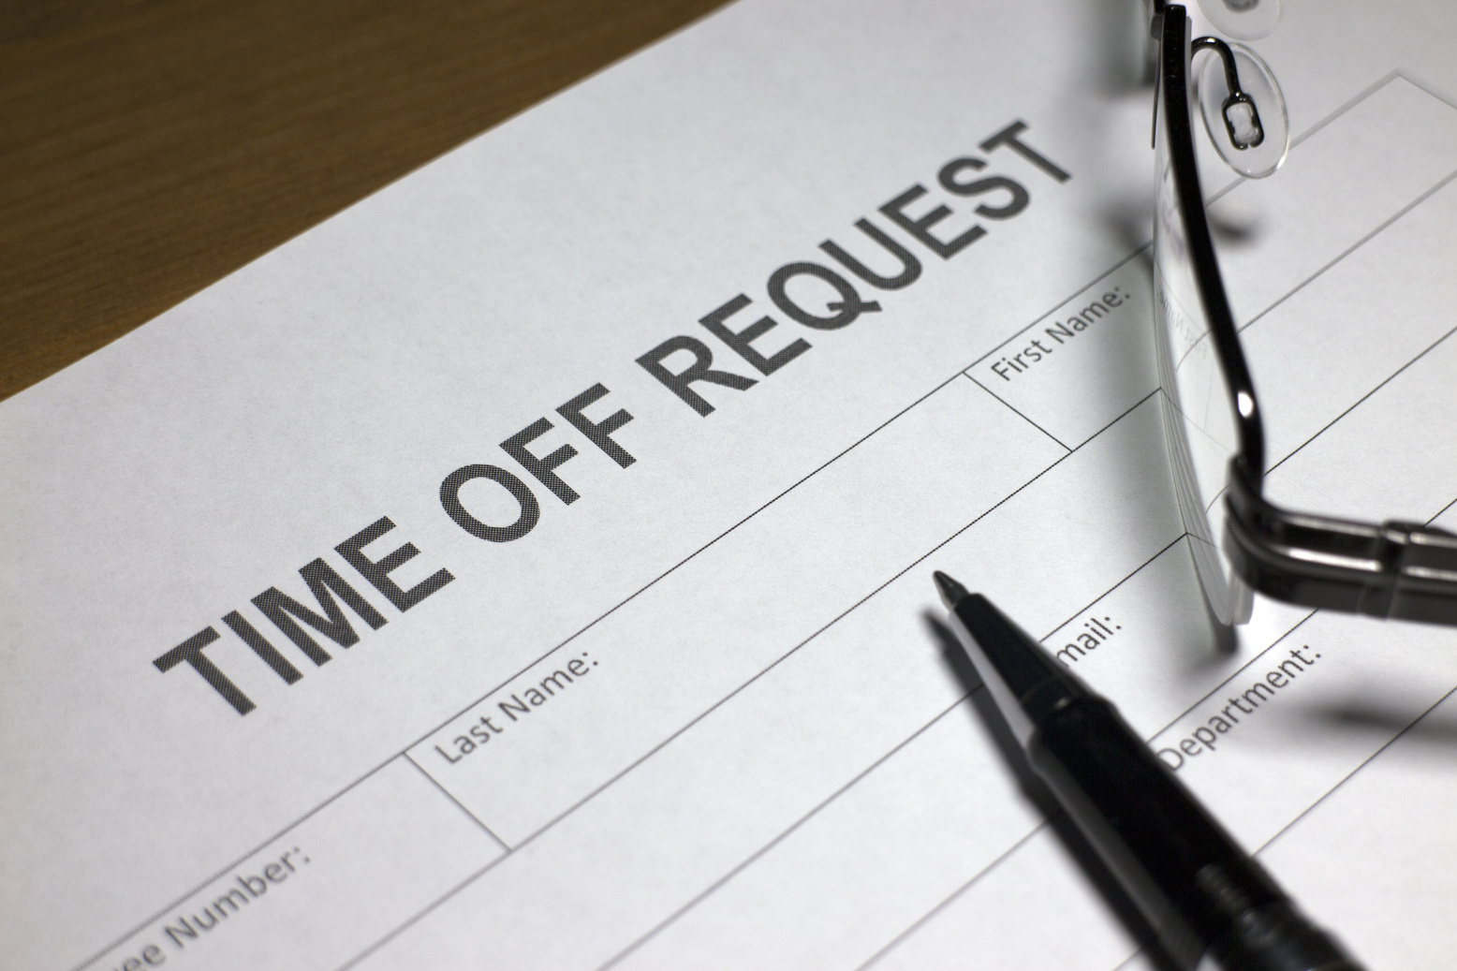
Administrative Process
Employees who fail to report PTO time taken or who engage in purposeful falsification of time entry may be subject to disciplinary action.
Employees who excessively use PTO time for non-approved absences may be subject to disciplinary action.

Slide 12
Supervision and Management
Supervisors must contact HR if they have made errors in approving time for an employee who reports to them.
Supervisors who fail to report PTO time taken by someone in their charge or who engage in purposeful falsification of time entry maybe subject to disciplinary action.

Slide 13
FAQ's and Links to Documents
FAQ's
Paid Time Off with Accrual Provision and Time Recording Policy
Family Medical Leave Act Policy
Short Term Disability Policy

Slide 14

Questions???

