Slide 1
2022 CDHP
Presentation

Slide 2
What is a CDHP and HSA?
A CDHP (Consumer Directed Health Plan) is a specific type of high deductible health plan that meets IRS requirements allowing it to be coupled with tax-advantaged personal Health Savings Account (HSAs).
An HSA is a tax-advantaged account available to qualified CDHP enrollees.
All employees will have access to the Health Savings Account (HSA); however, funding into the HSA is not available under specific circumstances (i.e., also covered under Medicare). For those ineligible for an HSA, the College will provide the same level of funding through a Health Reimbursement Arrangement (HRA).
Notes:
An HSA helps you put your own money aside for health care costs. It works like this: You put money from your paycheck into this account pre-tax dollars, and then you use it to pay your deductible and other medical and pharmacy expenses.
HSA accounts can be funded by the account owner and their employer. owners In order for you and Oberlin College to contribute to an HSA you must also be enrolled in an HSA-qualified CDHP. The College will also offer funds through a Health Reimbursement Arrangement (HRA) to employees who enroll in the CDHP plan if they are not eligible to contribute to HSAs (for example, if they are actively enrolled in Medicare).

Slide 3
Overview of Oberlin’s CDHP Plan
Employees will maintain access to the existing Medical Mutual and CVS Caremark networks
Our plan will maintain access to no-cost preventive care procedures and medications per ACA requirements
There will be no change to covered procedures or exclusions
Employees will see a reduced out-of-pocket maximum limit & reduced premiums
Coinsurance changes from 85%/15% to 80%/20% for those moving to the CDHP
Oberlin’s CDHP has a “true family deductible” meaning the entire family must meet the deductible before the plan begins to pay coinsurance
No copays or coinsurance for medical and pharmacy until deductibles are met
Oberlin will provide a first-year additional contribution to the HSA and HRA by funding 75% of your deductible, up from the standard Oberlin contribution of 50% of the deductible. Note: Employees will not need to complete wellness activity requirements in order to receive the College’s account funding.
Notes:
When you pick up prescriptions, you pay the discounted amount for drugs on CVS Caremark’s formulary until you meet your plan maximums. Be sure to refill your prescriptions before the end of the year.

Slide 4
Medical and Pharmacy Plans (PPO vs. CDHP)
 | 2021 PPO |  | 2022 CDHP*
 | In-Network | Non-Network | In-Network | Non-Network
Deductible (Medical and Rx Combined) Single Employee + Spouse/DP or Child(ren) Family | $1,500 $2,500 $2,500 | $3,000 $5,000 $5,000 | $2,000 - $1,500 Oberlin Funding = $500 $3,000 - $2,250 Oberlin Funding = $750 $4,000 - $3,000 Oberlin Funding = $1,000 | $4,000 $6,000 $8,000
Coinsurance after Deductible | 85% | 65% | 80% | 60%
Out-of-Pocket Maximum (deductible, copays, and coinsurance) Single Employee + Spouse/DP or Child(ren) Family | $6,000 $12,000 $12,000 | $12,000 $24,000 $24,000 | $4,000 $6,000 $8,000 | $8,000 $12,000 $16,000
Preventive Care | 100%, no deductible | 65% | 100%, no deductible | 60%
Office Visits (PCP / Specialist) | $30 / $40 | 65% after deductible | 80% after deductible | 60% after deductible
Inpatient / Outpatient Surgery | 85% after deductible | 65% after deductible | 80% after deductible | 60% after deductible
Diagnostic Imaging, Diagnostic Medical Tests, Diagnostic X-Rays | 100%, no deductible | 65% after deductible | 80% after deductible | 60% after deductible
Prescription Drugs Generic / Preferred Brand / Non-Preferred | $10 / $50 / $75, no deductible | Mail Order: x2 Retail, no deductible | 80% after deductible | 60% after deductible
Note: 10 out of the 115 employees enrolled in the CDHP plan met their Out-of-Pocket maximum during 2020.
*All family members combined must meet the family deductible before the out-of-pocket maximum is met.
Notes:
Diagnostics for preventive services, as defined under the ACA (Affordable Care Act) are covered at 100%.

Slide 5



HSA = Long-Term Health Savings Plan
Use Funds for Qualified Medical Expenses (no tax)
Withdraw Funds for any purpose (ordinary tax)
Age 65
Pre-Tax Contributions
Funds are Portable
Catch up Contributions at Age 55
$
No tax on interest & investments. Min. $1,000 balance to start investments.
Medicare Participants Cannot Contribute
$
Withdraw Funds to Pay for Qualified Expenses
20% Penalty for Early Withdrawal (nonqualified expenses)
Notes:
Tax-free contributions
Tax-free interest
Tax-free distribution when funds are used to pay for qualified medical, drug, dental and vision expenses
Unspent funds remain in the account, earn interest and can be invested
In addition to employees funding the account with pre-tax dollars, Oberlin College will also contribute to employees’ HSA accounts.
You may adjust the contribution amount throughout the year
Medical Mutual:
Minimum cash balance of $1,000 to start investments
Monthly investment fee of $2.50
Cash balance of $3,000 or more does not incur investment fees
No tax on interest and investments
Investment can be managed through our integrated online access portal
Mutual Fund selection option managed by Devenir with 31 options
10 out of the 115 employees enrolled in the CDHP plan met their Out-of-Pocket maximum during 2020.
Given the College’s first year contribution, it buffers out-of-pocket costs significantly.

Slide 6
Funding Accounts
COVERAGE TIERS
OBERLIN
CONTRIBUTES
YOU CAN CONTRIBUTE
IRS 2022 HSA
ANNUAL LIMITS
CATCH-UP CONTRIBUTION
Individual | $1,000 + $500 | $2,150 | $3,650 | Contribute an additional $1,000 if you are age 55 or older in 2022
Employee + Spouse or Child(ren) | $1,500 + $750 | $5,050 | $7,300
Family | $2,000 + $1,000 | $4,300 | $7,300
The amount you elect to contribute will be made on a per pay basis. Oberlin will make four quarterly contributions into your HSA (January, April, July and October). For the 2022 plan year, a one-time additional contribution will be made in January.
Note: Domestic Partner’s Medical Expenses Generally Not Eligible for Tax-Free HSA Distribution. For an eligible expense to qualify for a tax-free HSA distribution, the expense must be incurred by the employee (the HSA holder), the employee’s spouse (same-sex or opposite-sex), the employee’s tax-dependent child, or the employee’s qualifying relative tax dependent (e.g., a tax-dependent domestic partner).
Notes:
A domestic partner’s medical expenses will qualify for a tax-free distribution from the employee’s HSA only if the domestic partner qualifies as the employee’s tax dependent under IRC §152, as modified by §223(d)(2)(A).
Medical and Prescription Drug claims all count toward the deductible and out of pocket.
For 2022 plan year, Oberlin will provide a first-year additional contribution to the HSA by funding 75% of your deductible: Single: $1,000 + $500; Employee + 1 (spouse/domestic partner or child(ren): $1,500 + $750; Family - $2,000 + $1,000.

Slide 7
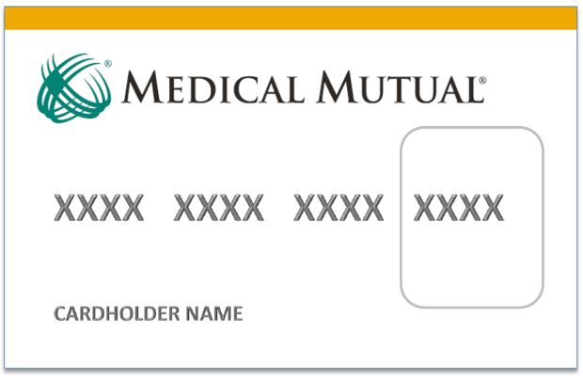
HSA/HRA Debit Cards
Oberlin College provides Medical Mutual with an eligibility file after open enrollment.
You will receive your welcome brochure and debit card in the mail.
Use the debit card at the pharmacy to pay for prescriptions, and pay providers for qualified medical, dental and vision services.

Slide 8
Resources for your HSA-Compatible Plan
MyHealthPlan
Register at MyHealthPlan.com
View your Health insurance and HSA in one place
Track deductibles and coinsurance
Access your EOBs (explanation of benefits)
Customer Support
Call 1-800-522-2037 for health insurance questions and HSA questions
Customer Care hours:
  M-F 7:30 am – 6:00 pm
MySpendingAccounts
Access through MyHealthPlan
View balances and transactions
Explore HSA resources and tools including tax savings calculator and self-service center
My Care Compare
Find cost estimates for services including lab work, office visits and surgeries
See quality ratings of doctors and hospitals
Watch video of what to expect by procedure

Slide 9
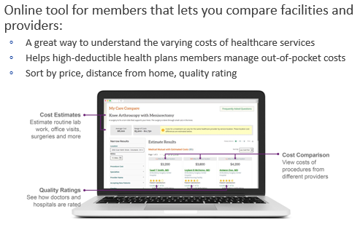
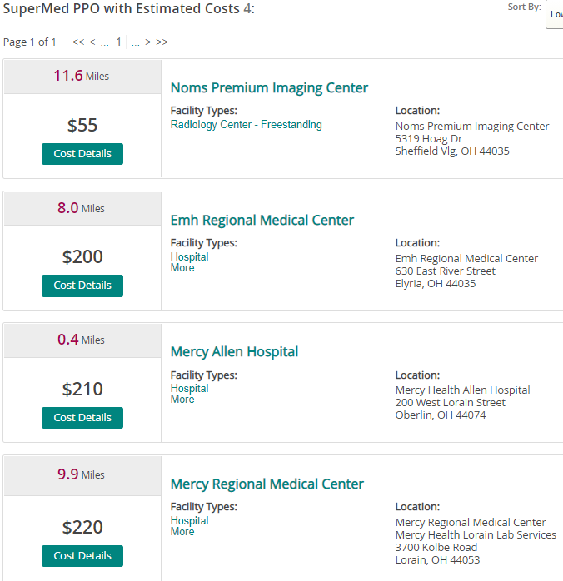

Medical Mutual My Care Compare
My Care Compare – Ankle X-Ray Sample
Medical Mutual’s mobile app has a GPS feature to help you find the nearest doctor, hospital or urgent care facility.
Then, get directions from your current location. You can also view quality and patient ratings for providers.

Slide 10
Using the Appropriate Place for Care
For non-life or limb-threatening injuries, such as pink eye, bladder infections, a sore throat, etc., using a lower-cost alternative for care like retail care clinics and urgent care centers as opposed to the emergency room will save you time and money.
If you need to use an emergency room for a true emergency, services rendered are treated as in-network benefits; however, any follow-up afterward must be done in-network.
If you are unsure if you should go to the emergency room or urgent care, call Medical Mutual’s Nurse Line at (888) 912-0636 (this number also appears on the back of your medical ID card). It’s staffed 24/7. If the nurse tells you to go to the emergency room, then your visit will be covered at the true emergency benefit level.
If you have chest pain, shortness of breath, dizziness, a severe headache, broken bone or other serious problems, please go to the nearest emergency department or dial 911.

Slide 11
Cleveland Clinic Express Care Online
Express Care Online allows video conferencing with a physician through a mobile app or on your computer. You can receive treatment for the following conditions:
Adults
Asthma
Children
(2–17 years old)
Bronchitis
Skin rashes
Bronchitis
Cough and cold symptoms
Earaches
Minor back and shoulder pain
Minor trauma, burns or lacerations
Seasonal allergies
Sinus infections
Skin rashes
Urinary tract infections
Yeast infections
Conjunctivitis
Cough and cold symptoms
Minor medical concerns
Seasonal allergies
Sinus infections
If you have chest pain, shortness of breath, dizziness, a severe headache, broken bone or other serious problems, please go to the nearest emergency department or dial 911.

Slide 12

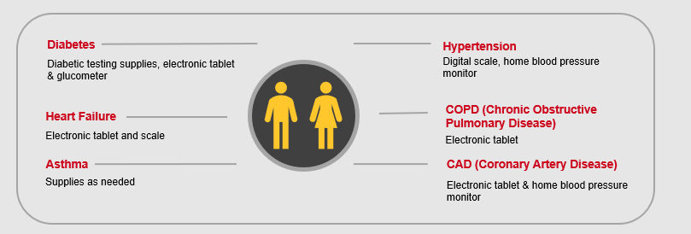


Chronic Condition Management Programs
All enrolled members are assigned a specially trained clinical coach. Members are provided with medical supplies at no cost.
Diabetes
Hypertension
Diabetic testing supplies, electronic tablet & glucometer
Digital scale, home blood pressure monitor
Heart Failure
COPD (Chronic Obstructive Pulmonary Disease)
Electronic tablet and scale
Electronic tablet
Asthma
CAD (Coronary Artery Disease)
Supplies as needed
Electronic tablet & home blood pressure monitor
  You can refer yourself by calling (800) 590-2583
Notes:
What you should know
Provided at no additional cost to you
No member cost sharing for diabetes testing supplies if you participate
Medical Mutual may reach out to members who could benefit from this program
Methods to identify members
Claims from provider visits
Case Management referral
Online Health Assessment through My Health Plan
Nurse Line referral
You can refer yourself by calling 1-800-590-2583

Slide 13

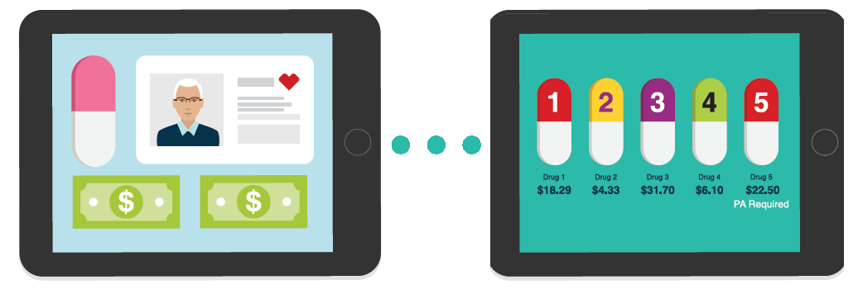
CVS Caremark
Important Tips
Sign in or register for an account at www.Caremark.com or use their mobile app to access the following tools to help you save money:
Drug Price Comparison Tool - CVS Caremark has a drug cost and coverage tool to help you check the cost of your medications at www.Caremark.com.
Retail vs. Mail Order - You can check the price difference between having your medications delivered or picking them up at the pharmacy and compare costs at different pharmacies.
Generic Drugs - When available, changing to the generic version of a drug can save you money. You can also price covered brand name, generics, or therapeutic alternatives on the site.

Slide 14
CVS Caremark
Important Tips
Specialty Medications – Manufacturer coupons help cover the cost of expensive specialty medications. For example, a drug may cost $3,000 and a manufacturer coupon limits your expense to $5. Note: Since the claim does not process through the drug plan, you will not receive credit toward your deductible and out-of-pocket maximum unless you submit a claim form.
No Cost Preventive Drugs – CVS Caremark provides certain preventive service benefits at no cost to you even if you haven’t met your deductible. These no-cost benefits are part of the Affordable Care Act (ACA). They include:
  Drugs and supplements to prevent certain health conditions for adults, women and children
  Medicine and products for quitting smoking or chewing tobacco (tobacco cessation)
  Medicine used prior to screenings for certain health conditions in adults
  Vaccines and immunizations to prevent certain illnesses in infants, children and adults
Track Your Accumulators – Track your deductibles and out-of-pocket maximums at www.Caremark.com.
Refill your prescriptions before the end of the year if you’re concerned about immediate out-of-pocket costs.

Slide 15
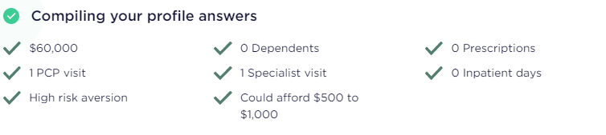
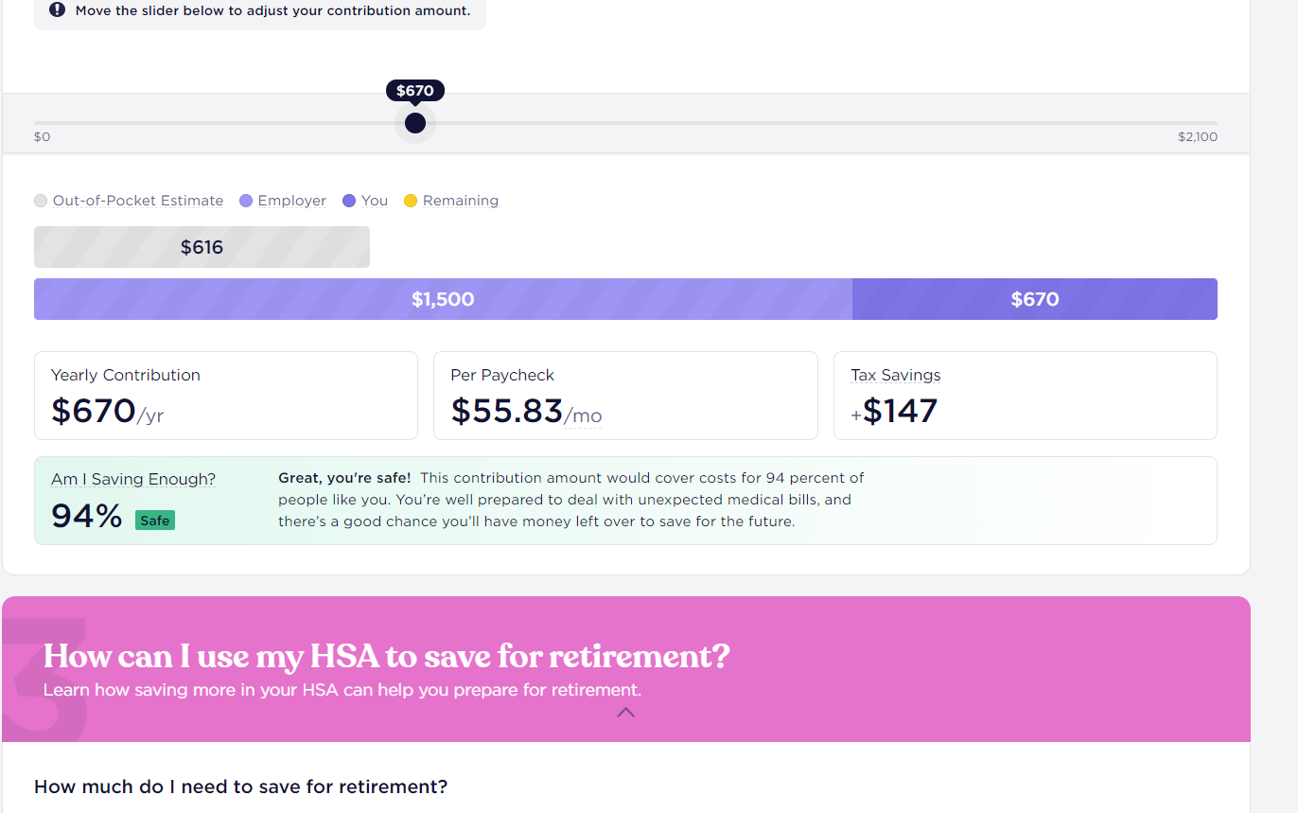
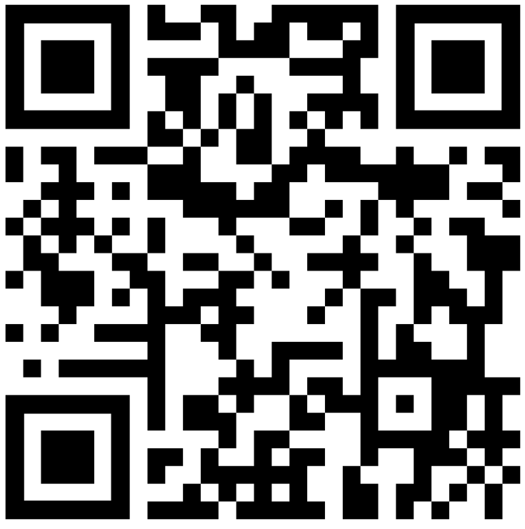
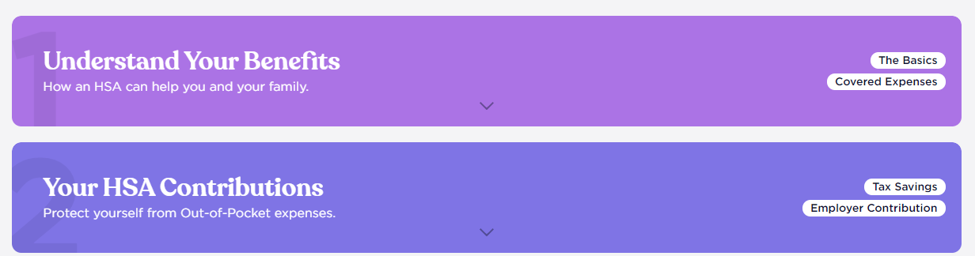
About Picwell
Founded by University of Pennsylvania economists
Provides over 4 million consumer health insurance recommendations annually.
Picwell is a customized website to help you decide the most suitable amount to contribute to your HSA:
oberlin.picwell.com
First, the site will ask you a few questions to assess your healthcare needs and preferences.
Then the online tool recommends a suitable HSA contribution amount.

Slide 16
HSAs, HRAs, and FSAs
 | Funding Accounts (HSA & HRA) | Health Care Flexible Spending Account (HC-FSA) | Dependent Care Flexible Spending Account (DC-FSA)
Eligibility | Must be enrolled in the CDHP plan | You cannot be enrolled in the CDHP-HSA plan | No restrictions that depend upon the medical plan
Qualified Expenses | Medical, Rx, Dental, Vision | Medical, Rx, Dental, Vision | Eligible Dependent Care Services
2022 Oberlin Annual contribution | Single: $1,000 + $500 bump = $1,500 EE + 1: $1,500 + $750 bump = $2,250 Family: $2,000 + $1,000 bump = $3,000 | Not applicable | Not applicable
Rollover | Unused balance rolls over year to year | None | None
Changes to contributions | HSA: Any time | Only during annual open enrollment | Only during annual open enrollment

Slide 17
HSA Account Setup
October | December | January
Enroll in the CDHP with HSA or HRA
Receive Welcome Kit and Debit Cards
First quarter Oberlin HSA Funds Available

Slide 18
Next Steps
    Open Enrollment: October 11, 2021 – October 29, 2021
    Refer to the Human Resources website for additional plan details.
    Contact Human Resources to determine your deadline to enroll. You will not be able to elect coverage until the next open enrollment unless a qualifying life event occurs.

