Slide 1


Medicare
WEBINAR
with

Slide 2
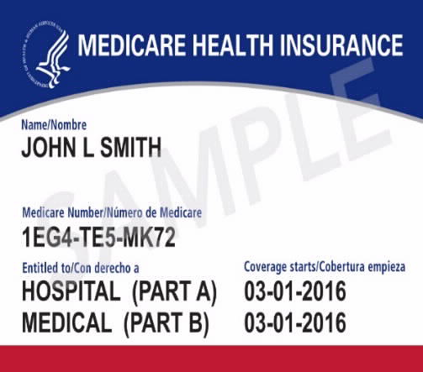
Who Can Get Medicare?
U.S. CITIZENS AND LEGAL RESIDENTS
Legal residents must live in the U.S. for at least 5 years in a row, including the 5 years just before applying for Medicare.
You must also meet one of the following requirements:
Age 65
Younger than 65 with a qualifying disability
Any age with a diagnosis of end-stage renal disease or ALS
Worked and paid taxes for at least 40 quarters (10 years)

Slide 3




What Does Medicare Cover?
Inpatient hospital care, home health services, skilled nursing facility care and hospice care
Premium-free
Deductibles and co-pays
Can’t be denied coverage
MEDICARE PART A

Slide 4

What Does Medicare Cover?
Physician visits, outpatient services, preventative services, medical equipment and some home health visits
Monthly premium, adjusted for income
Deductibles and coinsurance (80%/20% plan)
Can’t be denied coverage
Pay monthly from Social Security, EFT, credit card or check
Premium penalty for late enrollment
MEDICARE PART B

Slide 5
Medicare Doesn’t Cover Everything
ORIGINAL MEDICARE (PARTS A & B) DOES NOT COVER:
Prescription drugs
Routine dental, vision or hearing care
Eyeglasses and contacts
Hearing aids
Long-term or custodial care (e.g., help bathing, eating, dressing)
Excess charges for services by doctors who don’t accept Medicare assignment
Care received outside the U.S., except for certain circumstances

Slide 6
How Much Does Medicare Cost?
2021 MEDICARE PART B (MEDICAL) COST
Premium | Deductible | Other Costs | Note
$148.50 For Most People | $203 For The Year | 20% Of Approved Amount For Most Covered Services Excess Charges (If Any) | No Out-of-pocket Limit

Slide 7
Where Can I Get More Coverage?
OPTIONS FOR MORE COVERAGE
OPTION 1 ---------------- OR ---------------- OPTION 2
Add One or Both of the Following to Original Medicare (1965)
Choose a Medicare Advantage Plan
Medicare Supplement Insurance Plan (Medigap) Offered by private companies 1980
Helps pay some of the out-of-pocket costs that come with Original Medicare
Medicare Part D Plan Offered by private companies 2006
Part D Helps pay prescription drugs
Medicare Advantage Plan Offered by private companies 1997
Part C – Combines Part A (hospital insurance) and Part B (medical insurance) in one plan (HMO/PPO) Part D – Usually includes prescription drug coverage May offer additional benefits not provided by Original Medicare (i.e. dental, vision, hearing, gym membership

Slide 8

What is Medicare
Part D?
Average Medicare members take 4.2 to 4.5 prescriptions per month
Stand alone plan / Advantage Plan
Formulary
Network pharmacies
Offered through private insurance Companies
Premium / co-pays / deductible
63 days to join Medicare Part D to avoid a late enrollment penalty (LEP)
PRESCRIPTION DRUG PLAN

Slide 9

2022 Benefit Decision Chart
RETIREES, DEPENDENTS OF RETIREES
& SURVIVING SPOUSES
AGE 65 & OLDER
& ACTIVELY WORKING
Under Age 65
The College’s change to the CDHP plan effective 1/1/2022 will impact you. The College will make contributions into your HRA account on your behalf. You will not be able to make your own contributions into the HRA account as those contributions must run through payroll.
Age 65 and Over
Your current coverage options will not be impacted effective 1/1/2022. Please disregard emails pertaining to the change to the CDHP plans effective 1/1/2022.
Not Enrolled in Medicare
The College’s change to the CDHP plan effective 1/1/2022 will impact you. The College will make contributions into your HSA account on your behalf. You will also be able to make your own contributions to the HSA account through payroll deductions.
Enrolled in Medicare
The College’s change to the CDHP plan effective 1/1/2022 will impact you. You are still eligible to remain on the insurance; however, you will receive a Health Reimbursement Account (HRA) instead of a Health Savings Account (HSA) as the IRS prohibits pre-tax contributions into HSA accounts of Medicare recipients. You will receive the same funding amounts into the HRA as those with HSAs to help you meet your deductibles and plan maximums.
Have additional questions about Medicare and your options?
Phone: (216) 901-9300
www.medicareplansneo.com

Slide 10
Questions?
HOW CAN WE HELP YOU?
KAZ Company
Phone: (216) 901-9300
www.medicareplansneo.com

